Slide 1
The Technology Value Stream
CSD380-H307 DevOps
Module 1.2
Daniel Graham

Slide 2
Understanding the Technology Value Stream
The technology value stream describes every step required to turn an idea into working software.
It includes planning, coding, testing, deploying, and supporting applications in production.
DevOps focuses on improving how smoothly and quickly work moves through this entire process.

Slide 3
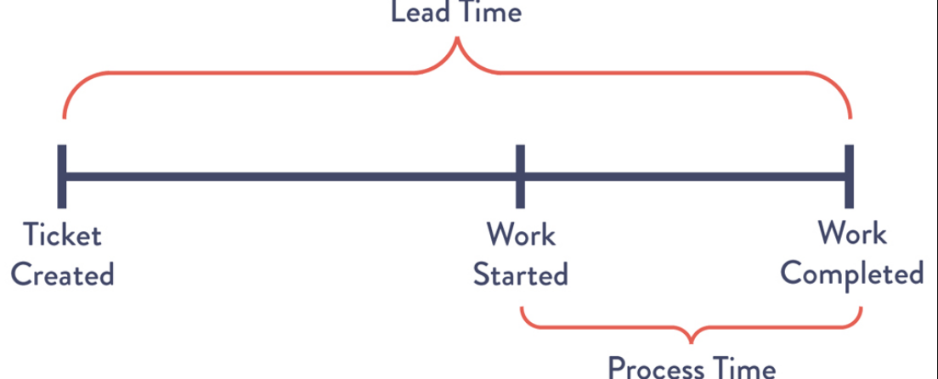
Lead Time and Process Time
Lead time is the entire timeframe from when work is requested until it is finished and delivered to the customer.
Process time starts when actual hands-on time is spent working on the task and ends when it is finished.
In many organizations, lead time is much longer than process time overall. (Kim et al., 2016).

Slide 4
Why Lead Time Matters
Customers will need to wait for the entire lead time, not just process time.
Even if coding takes only a few hours, delays caused by approvals, testing queues, mismanagement or handoffs can make delivery take weeks or months.
Reducing lead time helps organizations deliver value faster and increase customer satisfaction.

Slide 5
The Common Scenario: Long Deployment Lead Times
Traditional IT environments often require months to deploy changes.
This usually happens due to large release schedules, manual testing of releases, and teams working in silos.
Most of the delay comes from waiting, not from actual development work (Kim et al., 2016).

Slide 6
Challenges Created by Long Lead Times
Long deployment cycles increase team stress and risk of failure or financial loss during releases.
Problems are harder to trace because changes are bundled together in larger releases.
Customers wait longer for fixes and new features, which reduces overall satisfaction.

Slide 7
The DevOps Ideal: Fast and Frequent Deployments
DevOps aims to reduce deployment lead times to minutes or hours instead of months.
Small changes are released more frequently and iteratively, making problems easier to identify and fix quickly.
Automation plays a key role in making this possible (Kim et al., 2016).

Slide 8
How DevOps Improves the Value Stream
Deploying automation in the workflow increases deployment speed overall. It also reduces manual workloads and errors during testing and deployment.
Smaller batch sizes allow teams to get faster feedback and make more iterative updates.
Collaboration between development and operations teams improves overall flow.

Slide 9
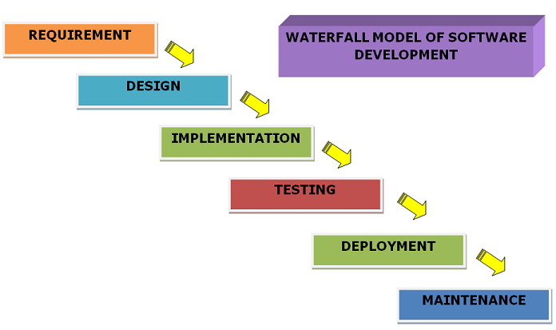
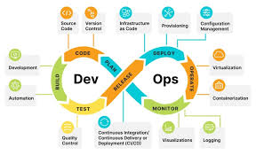
Traditional vs. DevOps Deployment Flow
Traditional Deployment
• Large releases
• Long waits
• Manual steps
• Months to deploy
DevOps Deployment
• Small changes
• Automation
• Fast feedback
• Minutes to deploy

Slide 10
Key Takeaways
The technology value stream shows how ideas become working software.
Long lead times are common in traditional IT environments and development cycles.
DevOps focuses on reducing delays and lead times so value reaches customers faster and teams work more efficiently overall.

Slide 11
References
The DevOps Handbook: How to create world-class agility, reliability, and security in technology organizations (2nd ed.). IT Revolution Press. Kim, G., Humble, J., Debois, P., Willis, J., & Allspaw, J. (2016).

